Slide 1
Part Three: Cloud Security Practices
Chapter 3.1
Key Management

Slide 2
Key Distribution
Have network with n entities
Add one more
Must generate n new keys
Each other entity must securely get its new key
Big headache managing n(n-1)/2 keys!
One solution: use a central keyserver
Needs n secret keys between entities and keyserver
Generates session keys as needed
Notes:
Note that a network with n entities has O(n^2) keys. Question: what ways could you handle distributing new keys?

Slide 3
Key Distribution Center (KDC)
Alice, Bob need shared symmetric key.
KDC: server shares different secret key with each registered user (many users)
Alice, Bob know own symmetric keys, K_{A-KDC} K_{B-KDC} , for communicating with KDC.

Slide 4
What is Kerberos?
Kerberos is a network authentication protocol. It is designed to provide strong authentication for client/server applications by using secret-key cryptography.
https://www.youtube.com/watch?v=VpBCJ8vS7T0

Slide 5
Kerberos History
Designed as part of MIT’s Project Athena in the 1980’s
Kerberos v4 published in 1987
Migration to the IETF
RFC 1510 (Kerberos v5, 1993)
Used in a number of products
Example: part of Windows 2000
MS Passport is essentially Kerberos
Notes:
Windows uses Microsoft Passport to authenticate users and help them to access protected resources and services.

Slide 6
Kerberos
Designed for single “administration domain” of machines & users: users, client machines, server machines, and the Key Distribution Center (KDC)
No public key crypto
Provides key management, authentication & encryption services
“Kerberized” servers provide authorization on top of the authenticated identities

Slide 7
Simplified Kerberos Model
Clients
Servers
The Authentication Server (AS)
Centralized trust model
AS is trusted by all clients & servers
AS shares a secret, symmetric key with each client and server

Slide 8


Picture of Simplified Kerberos
Authentication Server (AS)
(Database: K_{C},K_{S})
Server K_{S}
Client
K_{C}

Slide 9
Kerberos Credentials
Two types of credentials in Kerberos
Tickets
Authenticators
Tickets are credentials issued to a client for communication with a specific server
Authenticators are additional credentials that prove a client knows a key at a point in time

Slide 10
Simplified Kerberos Protocol
Assume client C wishes to authenticate to and communicate with server S
Phase 1: C gets a Ticket from the AS
Phase 2: C communicates with S

Slide 11
Protocol Definitions
C = client
S = server
TGS = ticket-granting service
K_{x} = x’s secret key
K_{x,y} = session key for x and y
{m}K_{x} = m encrypted in x’s secret key
T_{x,y} = x’s ticket to use y
A_{x,y} = authenticator from x to y
n_{x} = a nonce generated by x

Slide 12
Simplified Kerberos Protocol (1)
Phase 1: C gets a Ticket from AS for S
C sends a request to the AS for S
A ticket is used to talk to S
A ticket is relatively long-lived (8-24 hours typically)
C ➔ AS: C, S, Lt, n_{C}
where Lt denotes lifetime.
Sent in the clear!

Slide 13
Simplified Kerberos Protocol (2)
Phase 1: C gets a Ticket from AS for S
AS responds with two items
A ticket
A ticket for C to talk to S
A copy of the session key to use to talk to S, encrypted in C’s shared key
AS ➔ C: {K_{C,S}, S, Lt, n_{C} ...}K_{C} , {T_{C,S}}K_{S}
where T_{C,S} = {K_{C,S}, C, Lt … }
Only the S can decrypt the ticket
C can unlock the first part to retrieve K_{C,S}

Slide 14
Picture of Simplified Kerberos
Authentication Server (AS)
AS ➔ C: {K_{c,s}, S, Lt, n_{C} …}K_{C}, {T_{C,S}}K_{S}
where T_{c,s} = {K_{c,s}, C, Lt …}
C ➔ AS: C, S, Lt, n_{C}
Client

Slide 15
Simplified Kerberos Protocol (3)
Phase 2: C communicates with S
C sends the ticket to S along with an authenticator to establish a shared secret
C ➔ S: {C, ts, sk …}K_{C,S} , {T_{C,S}}K_{S}
where A_{c,s} = {C, ts, sk …}K_{c,s}
ts - a timestamp, sk - a session key
S decrypts the ticket T_{C,S} to get the shared secret K_{C,S} needed to communicate securely with C

Slide 16
Simplified Kerberos Protocol (4)
Phase 2: C communicates with S
S decrypts the ticket to obtain the K_{C,S} and replies to C with proof of possession of the shared secret (optional step)
S ➔ C: {ts, sk …}K_{c,s}
Notice that S had to decrypt the authenticator, extract the timestamp & session key, and re-encrypt the timestamp & session key with K_{c,s}

Slide 17
Picture of Simplified Kerberos
C ➔ S: {C, ts, sk … }K_{C,S} , {T_{C,S}}K_{S}
where A_{c,s} = {C, ts, sk … }K_{c,s}
Server
Client
{ts, sk …}K_{c,s} : C ← S

Slide 18
Kerberos Model
Clients
Servers
The Key Distribution Center (KDC)
Ticket Granting Server (TGS)
Centralized trust model
KDC is trusted by all clients & servers
KDC shares a secret, symmetric key with each client and server

Slide 19
Picture of Kerberos
Key Distribution
Center (KDC)
(Database: K_{C},K_{TGS})
Ticket Granting Server (TGS)
(Database: K_{TGS,}K_{S})
Server
K_{S}
Client
K_{C}

Slide 20
Kerberos Protocol
Assume client C wishes to authenticate to and communicate with server S
Phase 1: C gets a Ticket-Granting Ticket (TGT) from the KDC
Phase 2: C uses the TGT to get a Ticket for S
Phase 3: C communicates with S

Slide 21
Kerberos Protocol (1)
Phase 1: C gets a Ticket-Granting Ticket
C sends a request to the KDC for a “ticket-granting ticket” (TGT)
A TGT is a ticket used to talk to the special ticket-granting service
A TGT is relatively long-lived (8-24 hours typically)
C ➔ KDC: C, TGS, Lt, n_{C}
Sent in the clear!

Slide 22
Kerberos Protocol (2)
Phase 1: C gets a Ticket-Granting Ticket
KDC responds with two items
The ticket-granting ticket
A ticket for C to talk to TGS
A copy of the session key to use to talk to TGS, encrypted in C’s shared key
KDC ➔ C: {K_{C,TGS}, TGS, Lt, n_{C}}K_{C} ,{T_{C,TGS}}K_{TGS}
where T_{C,TGS} ={K_{C,TGS}, C, Lt …}
Only the TGS can decrypt the ticket
C can unlock the first part to retrieve K_{C,TGS}

Slide 23
Picture of Kerberos
Key Distribution
Center (KDC)
C ➔ KDC: C, TGS, Lt, n_{C}
KDC ➔ C: {K_{C,TGS}, TGS,Lt, n_{C}}K_{C} , {T_{C,TGS}}K_{TGS}
where T_{C,TGS} = {K_{C,TGS}, C, Lt …}
Client

Slide 24
Kerberos Protocol (3)
Phase 2: C gets a Ticket for S
C requests a ticket to communicate with S from the ticket-granting service (TGS)
C sends TGT to S along with an authenticator requesting a ticket from C to S
C ➔ TGS: {ts …}K_{C,TGS} , {T_{C,TGS}}K_{TGS}, S, Lt, n_{C}
First part proves to TGS that C knows the session key
Second part is the TGT C got from the KDC

Slide 25
Kerberos Protocol (4)
Phase 2: C gets a Ticket for S
TGS returns a ticket for C to talk to S
(Just like step 2 above...)
TGS ➔ C: {K_{C,S}, S, Lt, n_{C}}K_{C,TGS},{T_{C,S}}K_{S}
Only S can decrypt the ticket
C can unlock the first part to retrieve K_{C,S}

Slide 26
Picture of Kerberos
Ticket Granting Server (TGS)
C ➔ TGS: = {ts …}K_{C,TGS}, {T_{C,TGS}}K_{TGS},
S, Lt, n_{C}
TGS ➔ C: {K_{C,S}, S, Lt, n_{C}}K_{C,TGS} , {T_{C,S}}K_{S}
Client

Slide 27
Kerberos Protocol (5)
Phase 3: C communicates with S
C sends the ticket to S along with an authenticator to establish a shared secret
C ➔ S: {C, ts, sk…}K_{C,S}, {T_{C,S}}K_{S}
where A_{c,s} = {C, ts, sk, …}K_{c,s}
S decrypts the ticket T_{C,S} to get the shared secret K_{C,S} needed to communicate securely with C

Slide 28
Kerberos Protocol (6)
Phase 3: C communicates with S
S decrypts the ticket to obtain the K_{C,S} and replies to C with proof of possession of the shared secret (optional step)
S ➔ C: {ts, sk,…}K_{c,s}
Notice that S had to decrypt the authenticator, extract the timestamp & session key, and re-encrypt those two components with K_{c,s}

Slide 29
Picture of Kerberos
C ➔ S: {C, ts, sk, …}K_{C,S} , {T_{C,S}}K_{S}
where A_{c,s} = {C, ts, sk, …}K_{c,s}
Server
Client
S ➔ C: {ts,sk, …}K_{c,s}

Slide 30
Picture of Kerberos
Key Distribution
Center (KDC)
Ticket Granting Server (TGS)
Ticket Request
TGT Request
TGT
Ticket
Ticket + service request
“Do some stuff”
Server
Client

Slide 31
Thoughts on Kerberos …
Only the KDC needs to know the user’s password (used to generate the shared secret)
You can have multiple KDCs for redundancy, but they all need to have a copy of the username/password database
Only the TGS needs to know the secret keys for the servers
You can split KDC from TGS, but it is common for those two services to reside on the same physical machine

Slide 32
Thoughts on Kerberos…
Cross-realm trust is possible
Just need to share a secret key between the KDCs for the two domains...
Once accomplished, a user in domain A can get a ticket for a service in domain B

Slide 33
Thoughts on Kerberos…
“Time” is very important in Kerberos
All participants in the domain need accurate clocks
Timestamps are used in authenticators to detect replay; if a host can be fooled about the current time, old authenticators could be replayed
Tickets tend to have lifetimes on the order of hours, and replays are possible during the lifetime of the ticket

Slide 34
RNGs in Kerberos v4
Session keys were generated from a PRNG seeded with the XOR of the following:
Time-of-day in seconds since 1/1/2018
Process ID of the Kerberos server process
Cumulative count of session keys generated
Fractional part of time-of-day seconds
Hostid of the machine running the server
Notes:
RNG – Random number generation

Slide 35
RNGs in Kerberos v4 (continued)
The seed is a 32-bit value, so while the session key is used for DES (64 bits long, normally 56 bits of entropy), it has only 32 bits of entropy
What’s worse, the five values have predictable portions
Time is completely predictable
ProcessID is mostly predictable
Even hostID has 12 predictable bits (of 32 total)

Slide 36
RNGs in Kerberos v4 (continued)
Of the 32 seed bits, only 20 bits really change with any frequency, so Kerberos v4 keys (in the MIT implementation) only have 20 bits of randomness
They could be brute-force discovered in seconds
The hole was in the MIT Kerberos sources for seven years!

Slide 37
Diffie-Hellman Key Exchange
Discovered by Whitfield Diffie and Martin Hellman
“New Directions in Cryptography”
Diffie-Hellman key agreement protocol
Exponential key agreement
Allows two users to exchange a secret key
Requires no prior secrets
Real-time over an untrusted network

Slide 38
Introduction
Based on the difficulty of computing discrete logarithms of large numbers.
Requires two large numbers, one prime (P), and (G), a primitive root of P

Slide 39
Implementation
P and G are both publicly available numbers
P is at least 512 bits
Users pick private values a and b
Compute public values
x = gª mod p
y = g^{b} mod p
Public values x and y are exchanged

Slide 40
Implementation
Compute shared, private key
k_{a} = yª mod p
k_{b} = x^{b} mod p
Algebraically it can be shown that k_{a} = k_{b}=g^{ab}
Users now have a symmetric secret key to encrypt

Slide 41
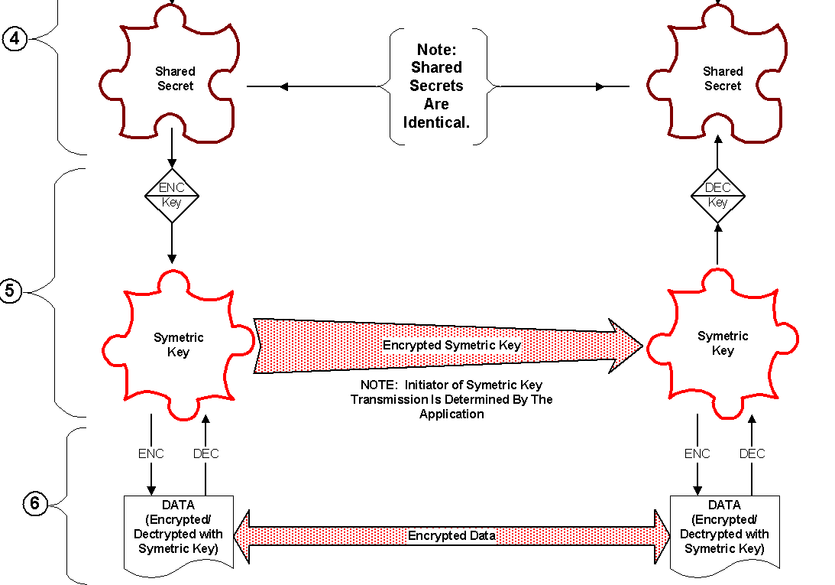
Implementation

Slide 42
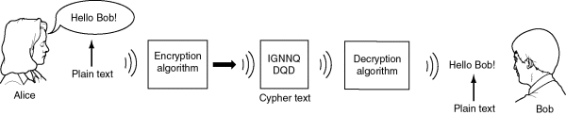
Example
Two Internet users, Alice and Bob wish to have a secure conversation.
They decide to use the Diffie-Hellman protocol

Slide 43
Example
Alice and Bob get public numbers
P = 23, G = 9
Alice and Bob compute public values
X = 9⁴ mod 23 = 6561 mod 23 = 6
Y = 9³ mod 23 = 729 mod 23 = 16
Alice and Bob exchange public numbers
Alice and Bob compute k_{a}=k_{b}=16⁴=6³=9

Slide 44
Applications
Diffie-Hellman is currently used in many protocols, namely:
Secure Sockets Layer (SSL)/Transport Layer Security (TLS)
Secure Shell (SSH)
Internet Protocol Security (IPSec)
Public Key Infrastructure (PKI)

Slide 45
Man-in-the-middle Attack
A, gª
E
A, g^{a’}
A
B
B, g^{b’}
B, g^{b}
g^{ab’}
g^{a’b}

Slide 46
Public Key Infrastructure (PKI)
PKI is a framework that binds public keys with respective user identities by means of a certificate authority (CA). The purpose of a PKI is to facilitate the secure electronic transfer of information for a range of network activities such as e-commerce, internet banking and confidential email.
https://www.youtube.com/watch?v=i-rtxrEz_E8

Slide 47
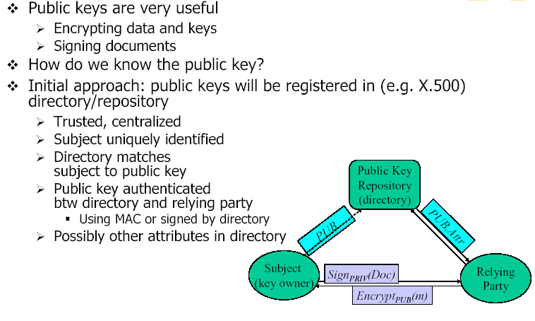
Relying on Public Keys

Slide 48
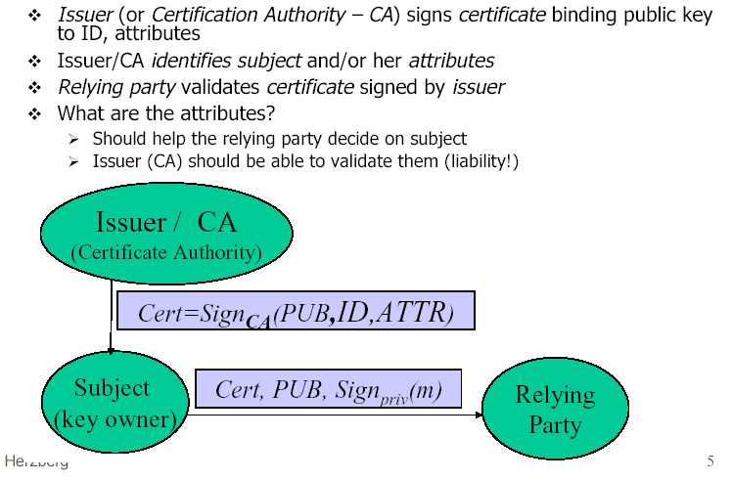
Public Key Certificate
Notes:
The macOS Trust Store contains trusted root certificates that are preinstalled with macOS.
https://support.apple.com/en-au/HT207189

Slide 49
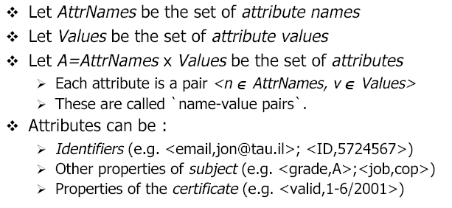
Certificate Attributes

Slide 50
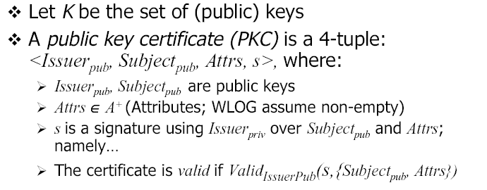
What’s a Public Key Certificate?

Slide 51
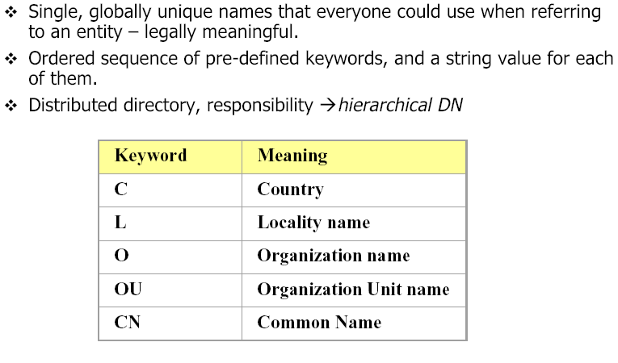
Distinguished Name (DN)

Slide 52
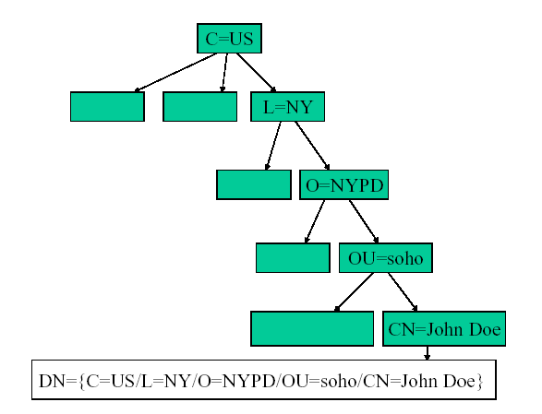
Distinguished Name Hierarchy

Slide 53
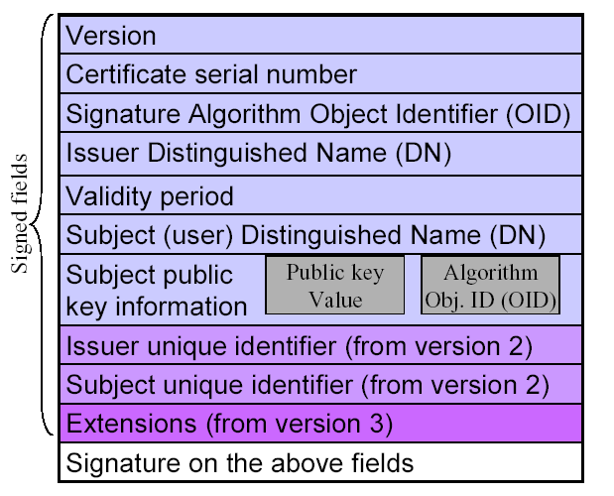
X. 509 Public Key Certificate

Slide 54
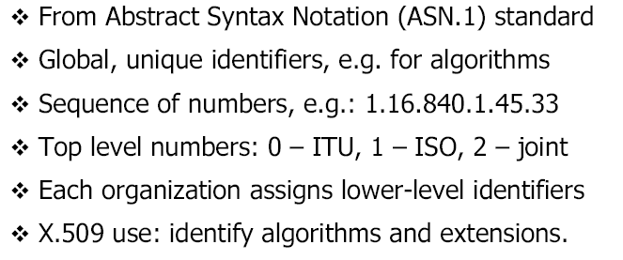
Object Identifiers (OID)
RSA encryption algorithm
http://www.oid-info.com/get/1.2.840.113549.1.1.1
Notes:
ITU - International Telecommunication Union
ISO - International Organization for Standardization
RSADSI stands for RSA Data Security, Inc.

Slide 55
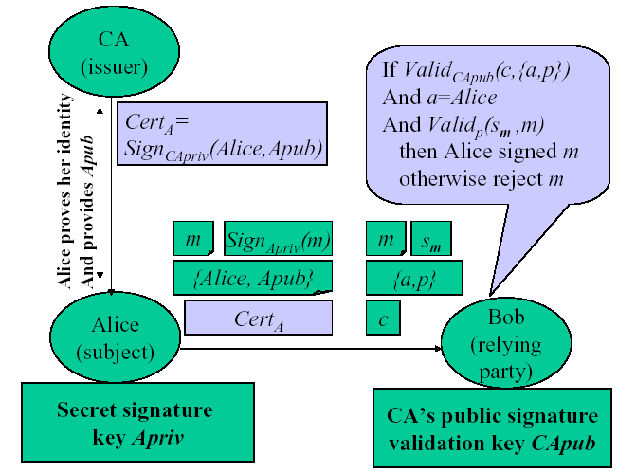
Certification Authority (CA)

Slide 56
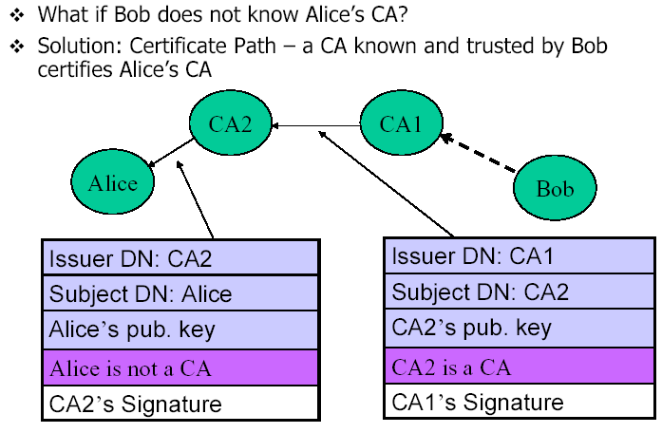
Certificate Path

Slide 57
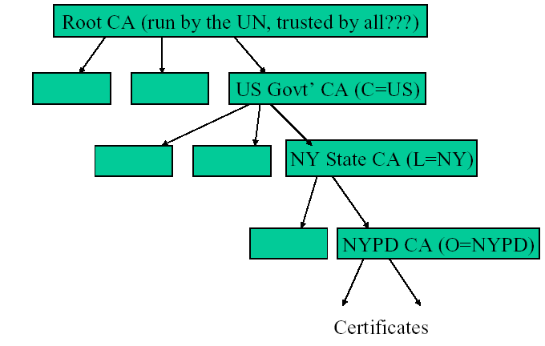
Global X. 509 CA Hierarchy

Slide 58
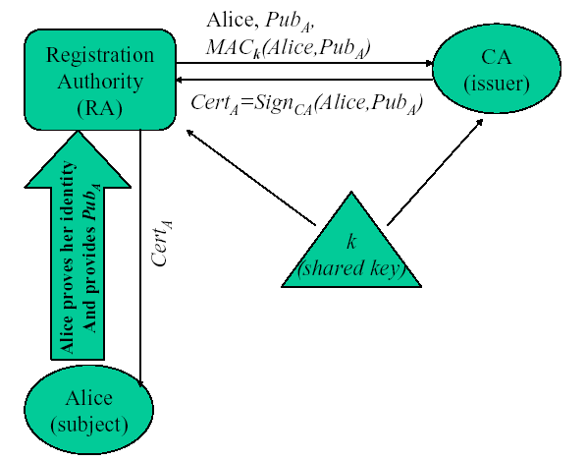
Issuing Certificate with Registration Authority

Slide 59
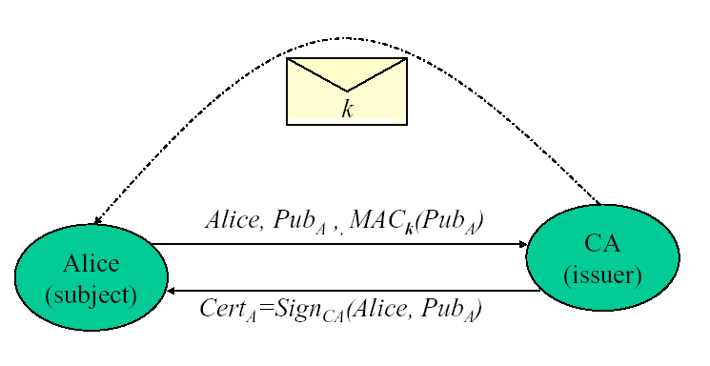
Issuing Certificate with
Shared Initial Key

Slide 60
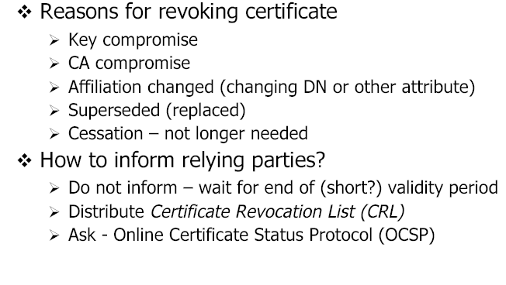
Certificate Revocation

Slide 61
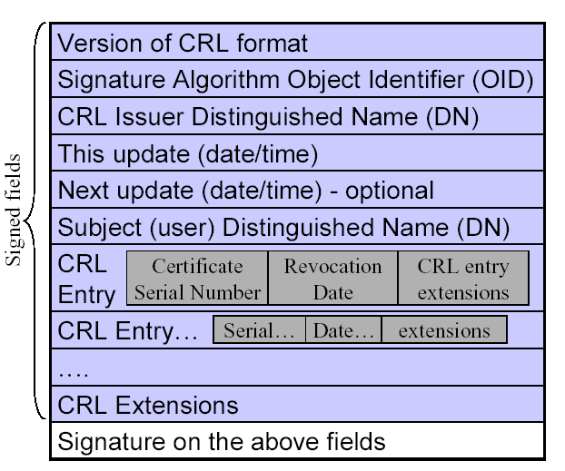
X. 509 CRL Format

